Slide 1
Anaconda (Python3) in Ubuntu

Slide 2
ToDo List
https://www.continuum.io/downloads#_unix
- Download 2.7 or 3.x version
cd ~/Downloads
bash Anaconda2-4.0.0-Linux-x86_64.sh
or
bash Anaconda3-4.0.0-Linux-x86_64.sh
(While installing Anaconda)
Press Enter
Type yes
Press Enter
Type yes
Re-run Terminal
conda install -c https://conda.anaconda.org/jjhelmus tensorflow
jupyter notebook

Slide 3
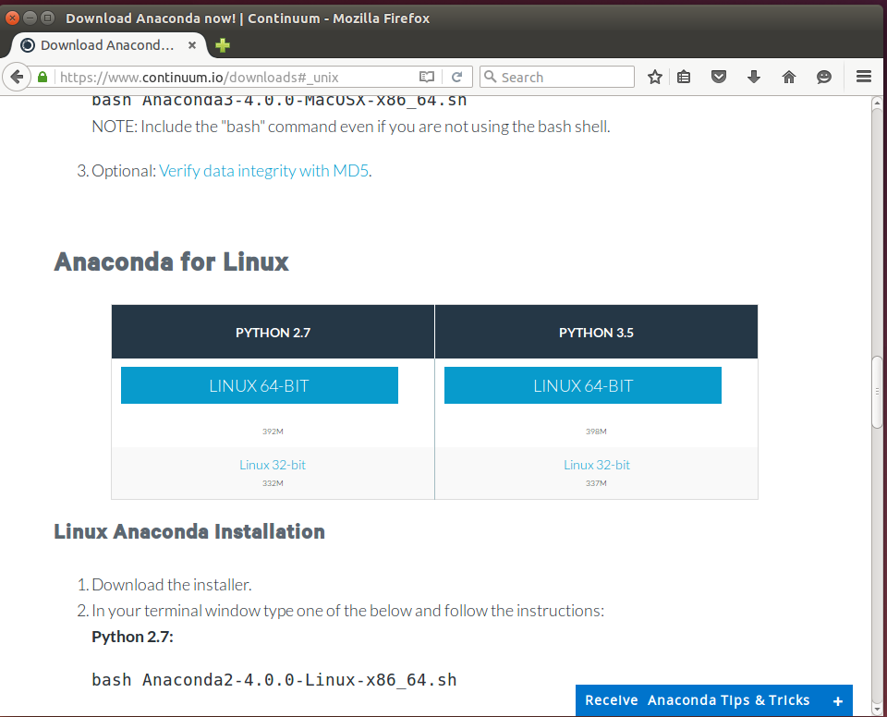

Slide 4
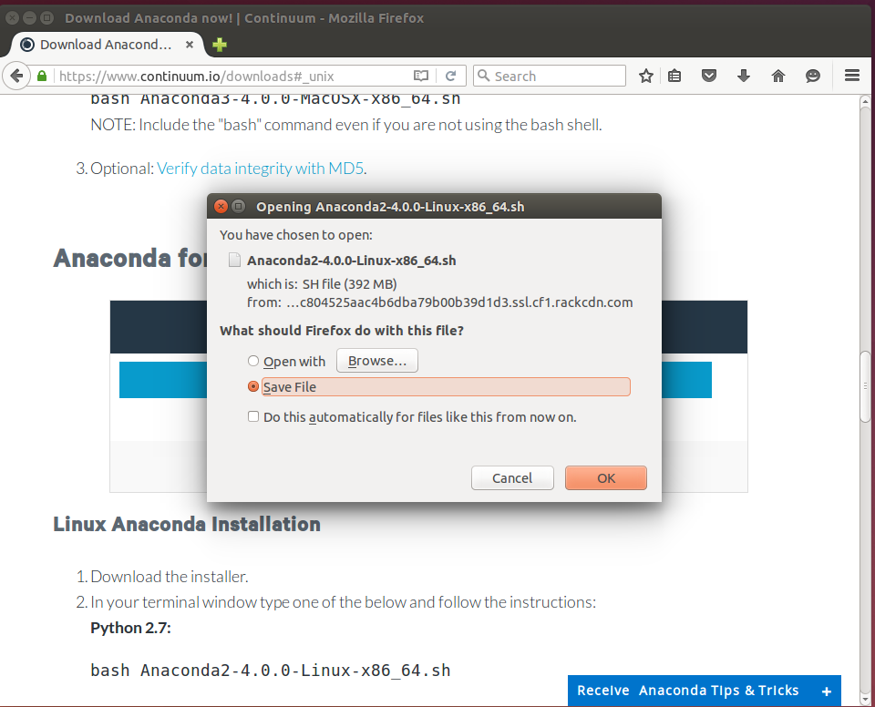

Slide 5
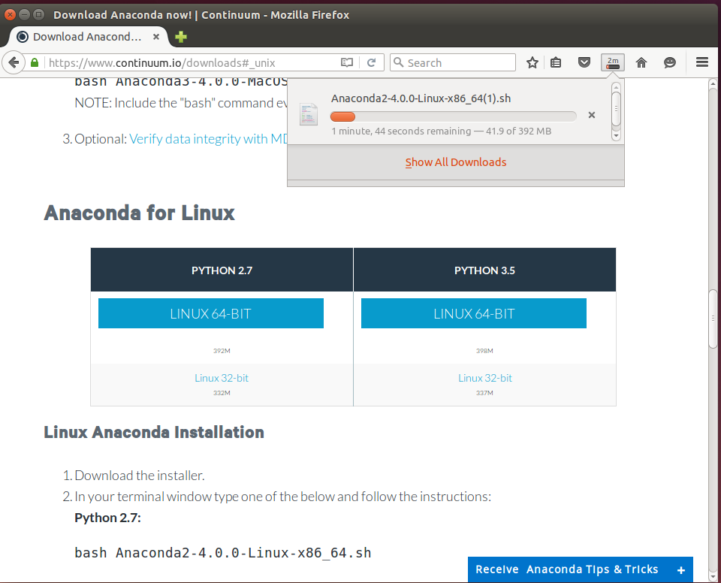

Slide 6
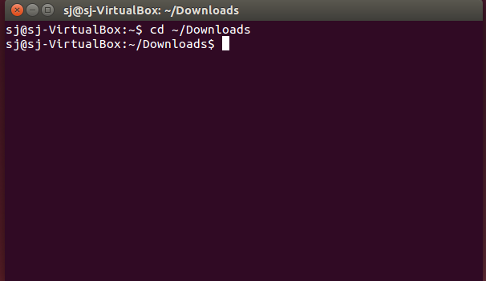

Slide 7
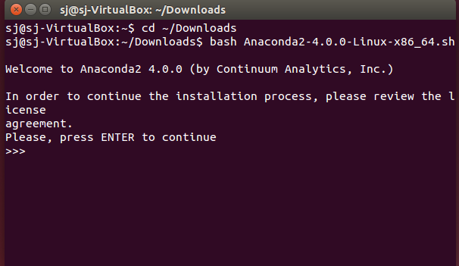

Slide 8
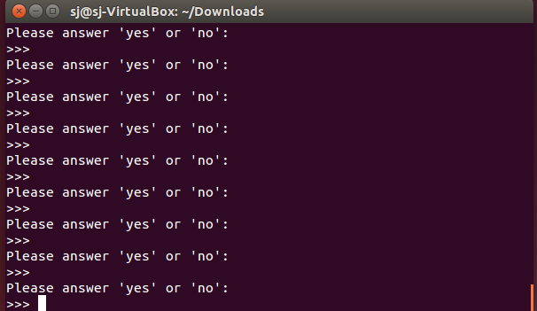

Slide 9
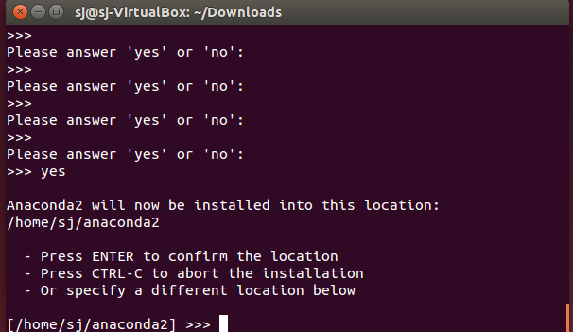

Slide 10
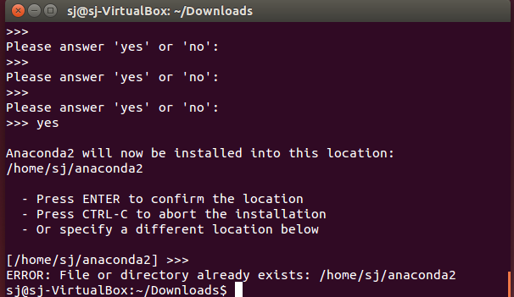

Slide 11
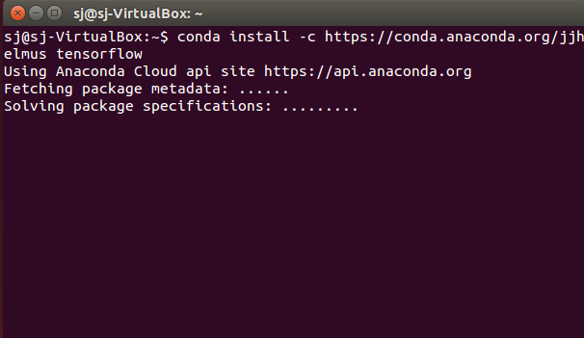

Slide 12
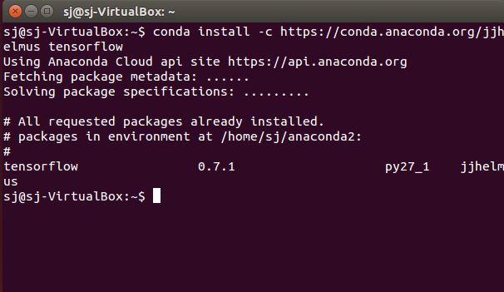

Slide 13
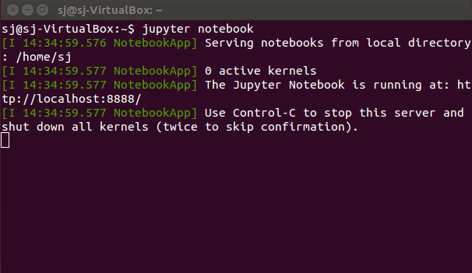

Slide 14
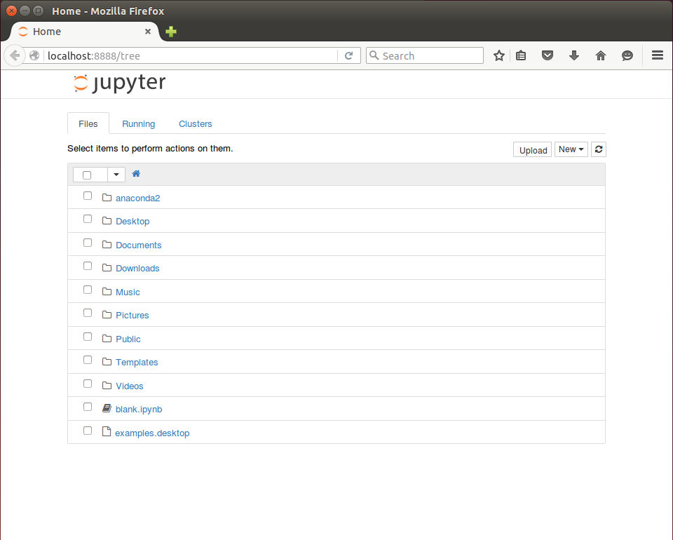

Slide 15
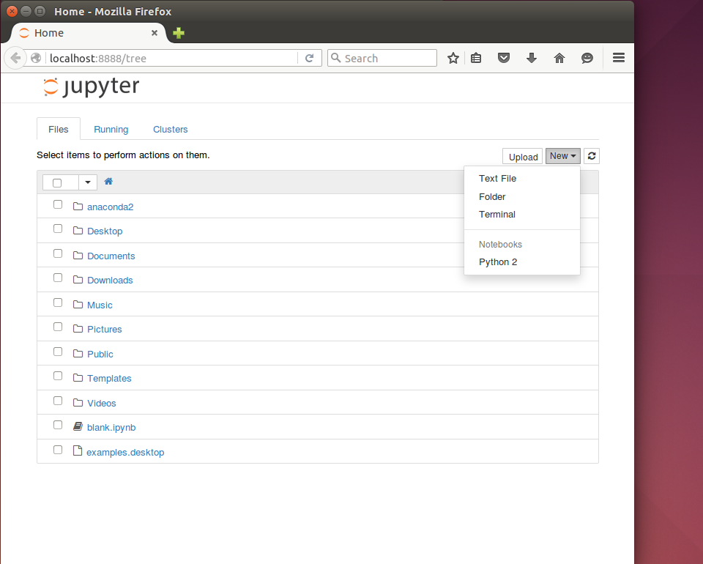

Slide 16
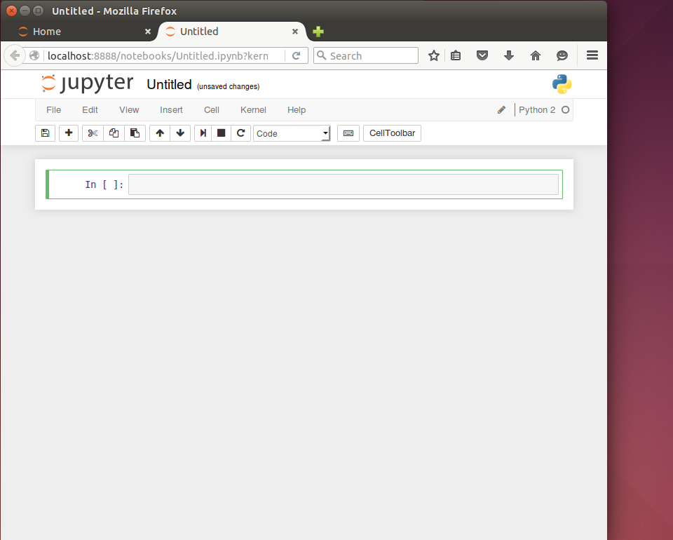

Slide 17
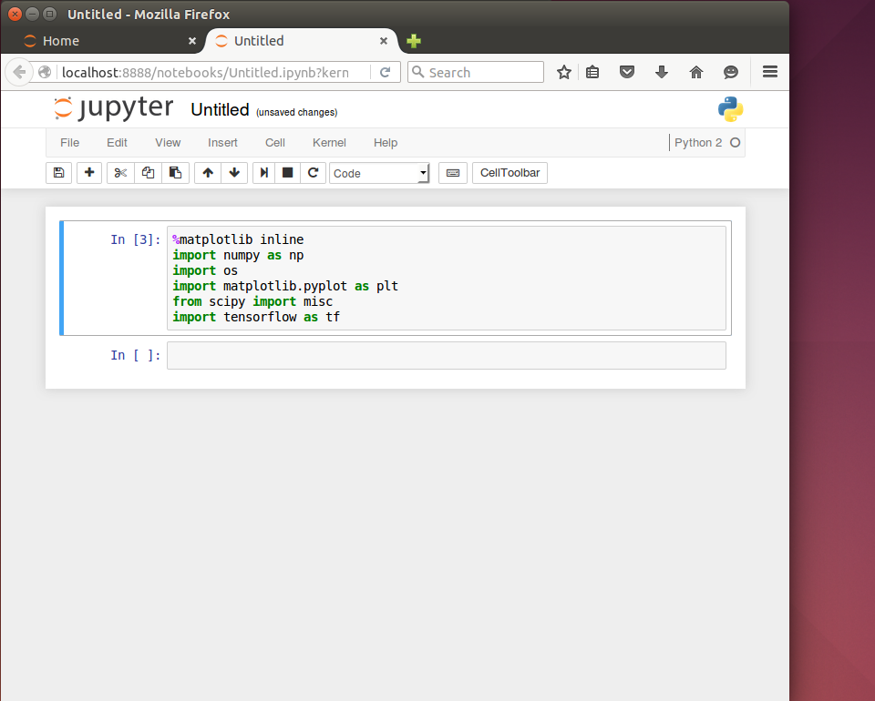

Slide 18
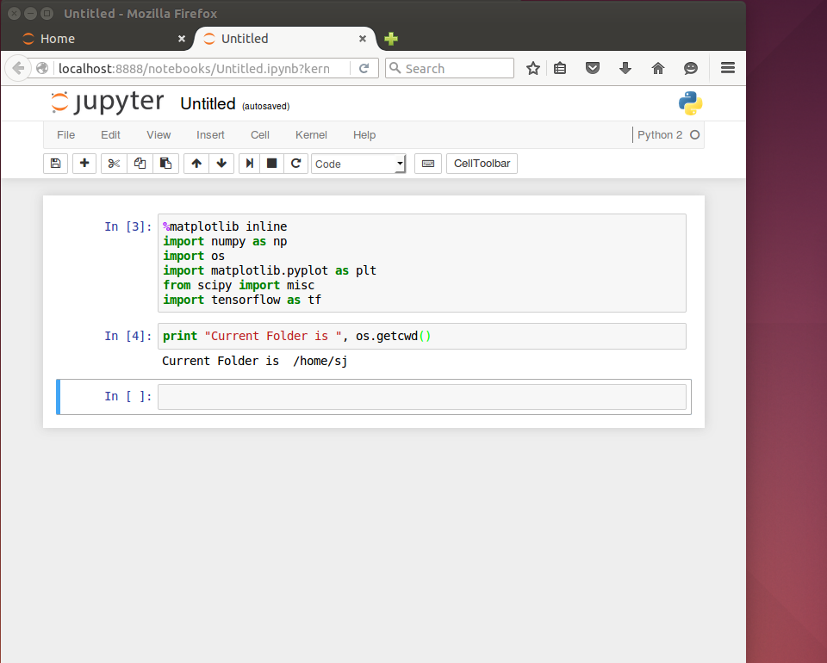
실행은 Shift+Enter 입니다.
에러가 안 나면 된 거에요.

Slide 19
터미널에서
conda install opencv

